Slide 1
OTC Special Sales Processes

Slide 2
Lesson Objectives
Purpose
Use
Challenges
Different Special Sales Processes in SD
  Cash Order Sales
  Rush Order Sales
  Consignments
    Consignment Fill Up
    Consignment Issue
    Consignment Returns
    Consignment Pick Up
  Free Of Charge Delivery
  Subsequent Delivery Free Of Charge
  Third Party Sales
Notes:
Add instructor notes here.

Slide 3
Lesson Objectives
  Intercompany Stock Transfer
Configurations
  Cash Sales
  Cash Order Sales
  Rush Order Sales
  Consignments
    Consignment Fill Up
    Consignment Issue
    Consignment Returns
    Consignment Pick Up
  Free Of Charge Delivery
  Subsequent Delivery Free Of Charge
  Intercompany Stock Transfer
  Transactions

Slide 4
Purpose
The sole purpose of selling is to create a customer, to keep him &
ensure profits follow
The Business, therefore engages itself in developing and
maintaining its market, focusing on customer needs, coordinating all
the activities that will affect customer end produces and thereby
profiting from its satisfied customers
The Business therefore needs to adopt special sales processes to
meet the customers requirement and thus keeping its competitors at
bay
Special sales processes depend upon the nature of the goods being
sold, circumstances of the sale and the customers being dealt
Notes:
Add instructor notes here.

Slide 5
Use
Special Sales Processes deals with specialized sales scenarios in
addition to the regular sales activities being carried out
Sales that are made for ready money, in distinction from those on
which credit and where the stocks are sold and delivered on the day
of transaction are represented using Cash Sales and Rush Order
processes
Scenario where the business places some of its inventory in its
customer’s possession and allows them to sell or consume directly
from its stock is best represented thru consignment sales process
Distribution of free goods or issues related to material shortages,
quality can be covered separately using Free of Charge and
Subsequent deliveries option
Notes:
Add instructor notes here.

Slide 6
Use(Continued…)
Scenarios where the customer places an order for a material which
is not kept/available in stock but which the business procures from
an external vendor or from other plant belonging to the same group
are represented by the third party sales and inter company stock
transfers
Thus the business stands to –
  Gain greater control of the process
  Improve customer service
  Reduce manual effort and associated errors

Slide 7
Challenges
Differentiation of the different sales processes for status updates, control and monitoring
Pricing for varied sales activities
Confirmation of material availability and deliveries
Monitoring and tracking of the inventory, esp. in case of consignments
Postings-both units and valuation, to be made to FI for the goods moved
Automatic synchronization and updates of trading documents

Slide 8
Different Special Sales
Processes in SD

Slide 9
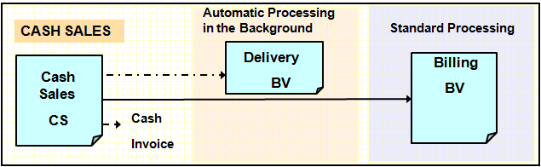
Cash Sales
Cash sales is a sales process wherein the customer orders, picks up and pays for the goods immediately
The delivery is processed as soon as the order is placed and the customer picks up the goods from the stores on the same day.
Cash payment is taken from the customer and cash invoice is printed.
The customer payment is entered into the cash account

Slide 10
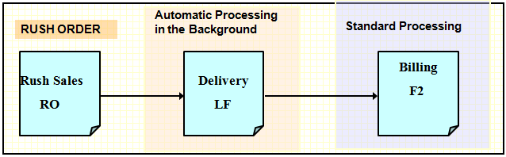
Rush Order Sales
Rush order is used when the customer wants to picks up the goods immediately or when the goods have to be delivered the same day
The delivery document is created automatically as soon as the order is placed.
Billing is processed in the standard way-based on the delivery

Slide 11
Consignments
Refers to those goods which are stored at the customer’s location but are owned by the business
Consignment quantity is monitored and controlled separately from the rest of the stock
Customer pay’s only for those goods used or consumed from the consignment stock
Customer can usually return consignment goods which are not required
4 main transactions for processing consignment stock
Consignment Fill Up | Consignment Returns
Consignment Issue | Consignment Pick Up

Slide 12
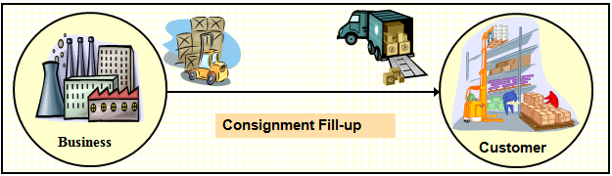
Consignment Fill Up
When consignment stock is shipped to the customer, the transaction is referred to as consignment fill-up
In consignment fill-up, goods are delivered to the customer but they remain the property of the business
The transaction is not relevant for pricing and billing. Hence no invoice is generated

Slide 13
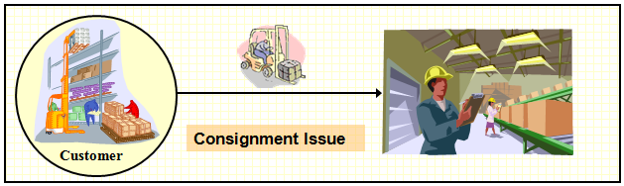
Consignment Issue
Consignment issue enables the customer to take consignment goods from the special stock for their use
Customer or the consignee may use the stock at his site and indicates the business of the same
Consignment stock that is used now becomes the property of the customer
Customer pays only for those quantity of goods consumed by him

Slide 14
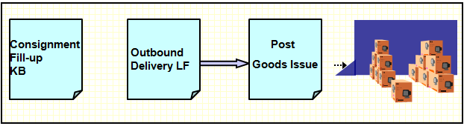
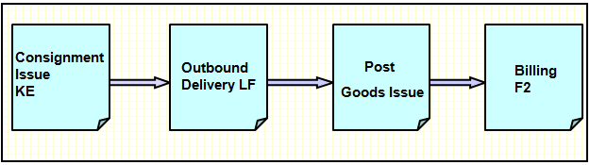
Process Flow
Consignment Fill Up
Consignment Issue

Slide 15
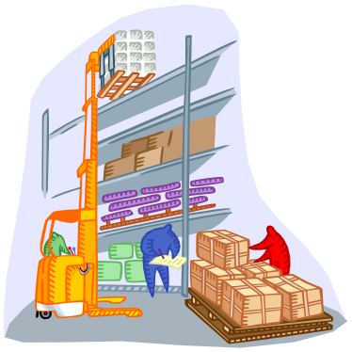
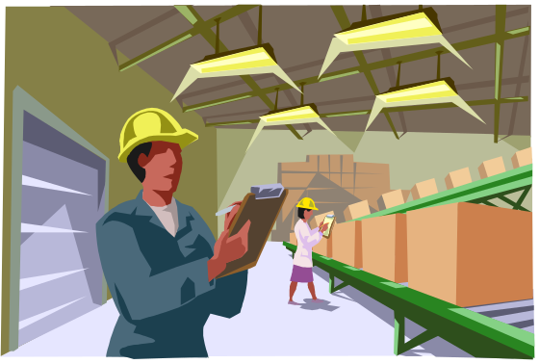

Consignment Returns
Consignment Return involves the return of already issued consignment goods, by the customer, back to the consignment stock because either they are damaged or they don’t need it
The transaction is relevant for billing as the stock changes ownership and is again regarded as part of business inventory
The customer may then request for a credit note for returns
Consignment Returns
Customer

Slide 16
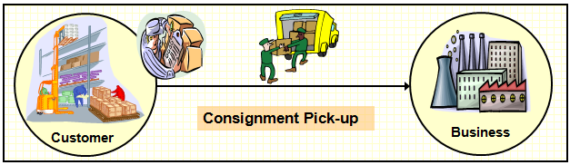
Consignment Pick Up
Consignment Pick-up involves the return or reposting of any unused consignment goods stored at the customer’s place, back to the business warehouse.
The transaction is not relevant for billing as the returned stock is regarded as part of business inventory

Slide 17
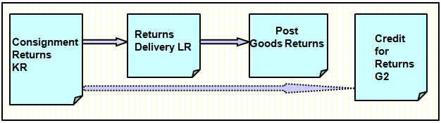
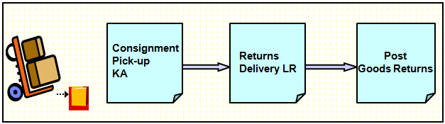
Process Flow
Consignment Returns
Consignment Pick Up

Slide 18
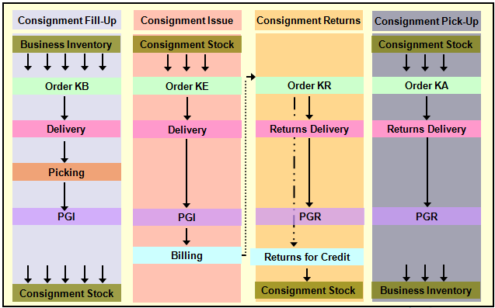
Consignment Sales

Slide 19
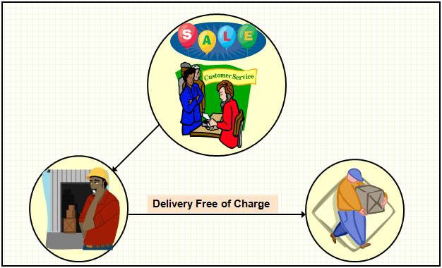
Free Of Charge Delivery

Slide 20
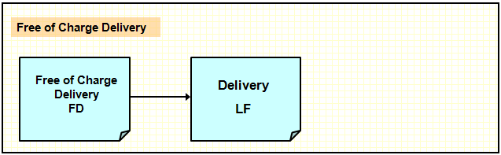
Free Of Charge Deliveries
A Free of Charge Delivery is used to send samples or free products to the customer free of charge
The customer is not billed for the goods delivered
For example we get free shampoo samples in newspapers

Slide 21
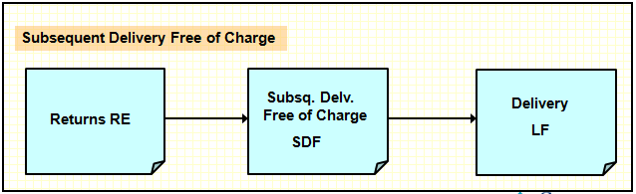
Subsequent Delivery Free Of Charge
When a customer receives lesser number of goods than that ordered, or if the goods have been damaged in the shipment, businesses provide free-of-charge subsequent delivery of goods
A subsequent delivery of charge is usually created with reference to the previous order
The transaction is not relevant for pricing and hence no billing takes place

Slide 22
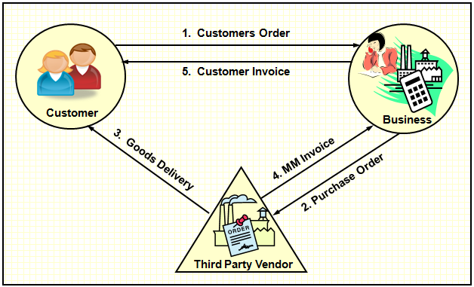
Third Party Sales

Slide 23
Third Party Order
The business passes the order from the customer, to a third-party vendor who then ships the goods directly to the customer and bills the business
When a third party order is saved, purchase requisition is automatically created and forwarded to the purchase department
The purchase department then creates the purchase order on the third-party vendor indicating that all goods are to be delivered directly to the customer
The vendor delivers the goods to the customer and bills the business for the same
The business then bills the customer for the goods delivered by the vendor after verifying the invoice receipt

Slide 24
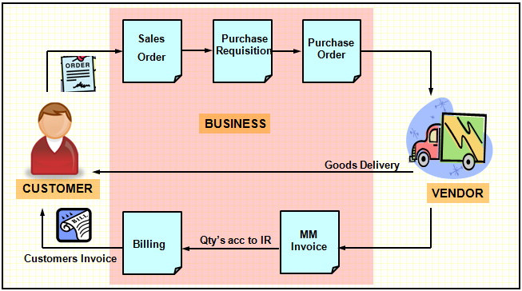
Third Party Sales

Slide 25
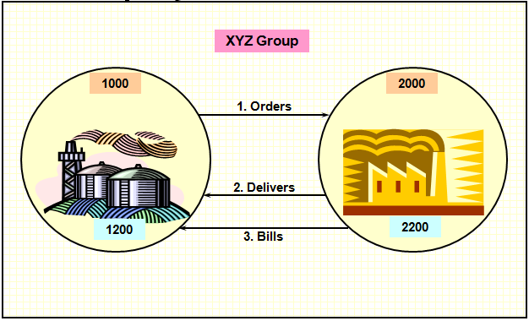
Intercompany Stock Transfer

Slide 26
Intercompany Stock Transfer(Continued…)
Involves transfer of stock from one plant to another wherein the plants belong to different company codes
Ordering/receiving plant places a stock transport order on the delivering plant
Delivering plant then creates a delivery document on the basis of the purchase order received
Delivering plant then bills the receiving plant by means of inter company billing.
An incoming invoice with reference to the purchase order can be posted in the following ways -
  Manually, after the invoice has been checked
  Automatically, with an internal billing document via SAP EDI

Slide 27
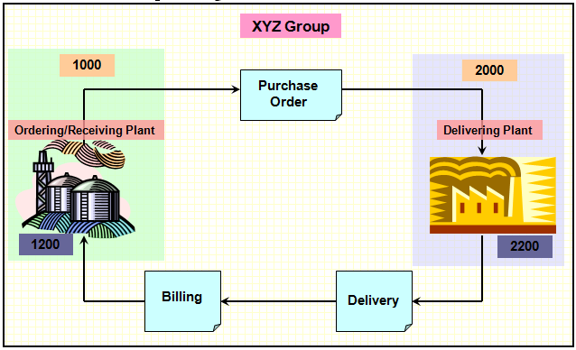
Process Flow

Slide 28
Pre-requisites
The ordering sales organization and delivering plant must belong to different company codes
Required combination of Sales Area and Delivering Plant have to be maintained
Material must exist in all the sales areas and plants participating in Inter Company Stock Transfer
An internal customer number must be created and assigned to the ordering plant , and this internal customer number must be extended to the sales area of the supplying plant
Purchasing document type is to be assigned to the respective supplying and receiving plants
Delivery type is to be assigned to the replenishment delivery

Slide 29
Configuration

Slide 30
Cash Order Sales
Represented by the document type- CS
Delivery type-BV and order related billing type-BV are configured
Immediate Delivery-X and shipping conditions-10 auto trigger immediate creation of the delivery in the background
The system automatically proposes the current date as the date for delivery and billing
Cash sale is billed using order related billing process

Slide 31
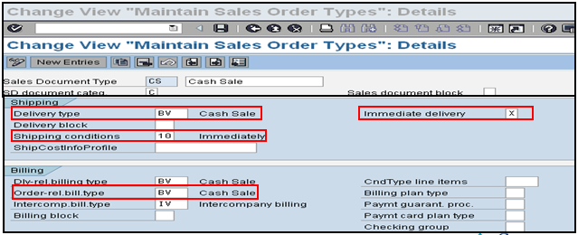
Cash Sales Order

Slide 32

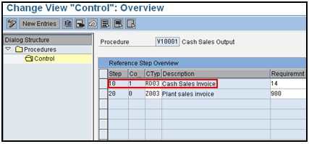
Cash Order Sales
Cash Sale Invoice is printed with output type RD03, contained in the output determination procedure for order type CS
The system does not print invoices during billing

Slide 33
Rush Order Sales
Represented by the document type- RO/SO
Delivery type-LF and delivery related billing type-F2 are configured
Immediate delivery option is switched on ensuring automatic creation of the delivery document in the background
Billed using delivery related billing process

Slide 34
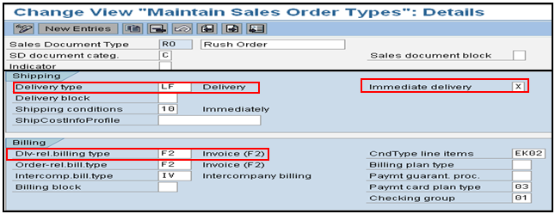
Rush Order Sales

Slide 35
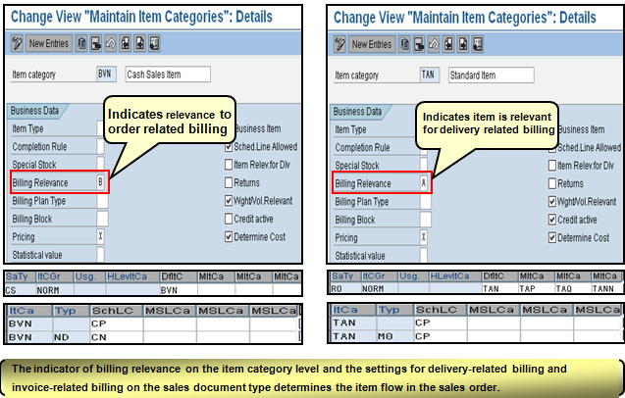
Cash Order Vs Rush Order

Slide 36
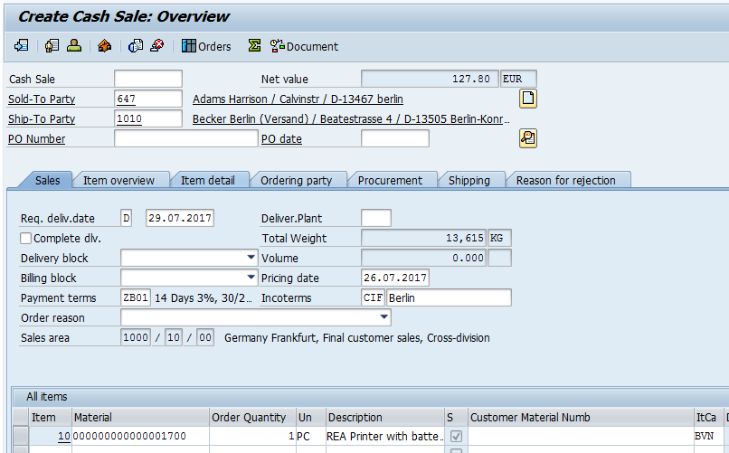
Cash Order Vs Rush Order

Slide 37
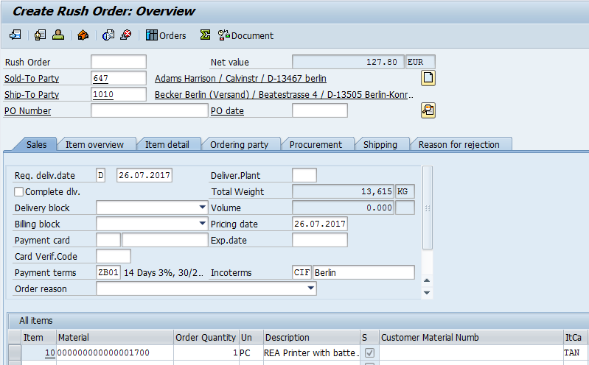
Cash Order Vs Rush Order

Slide 38
Consignment Fill Up
Represented by the order document type – CF/KB
Standard delivery type – LF is used
The document is not relevant for billing. Hence no values are maintained for delivery and order-related billing types
The standard item category used by consignment fill-up – KBN is not relevant for pricing and billing

Slide 39
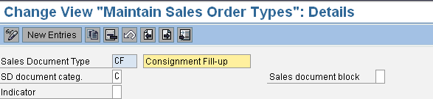
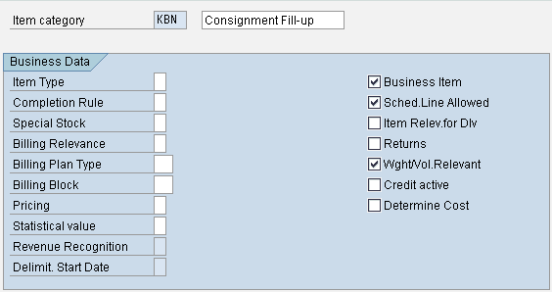
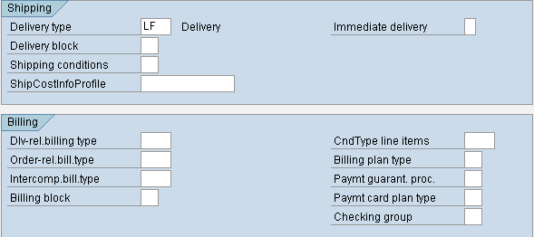

Consignment Fill-up

Slide 40
Consignment Fill-up – Schedule Line Category
The consignment fill-up uses the schedule line category E0 or E1
Schedule line category E1 is used with MRP and uses availability checking
Availability check is carried against the stock in the delivering plant.
Movement Type-631 enables the posting of the goods into a special consignment category in the delivering plants stock for that particular customer and material

Slide 41
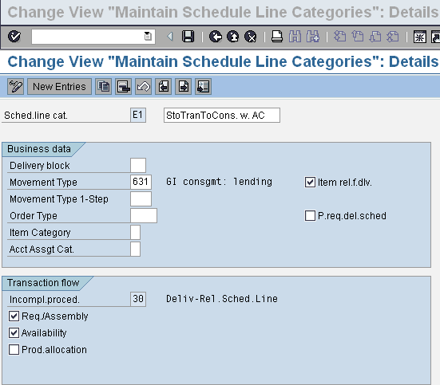

Consignment Fill Up

Slide 42
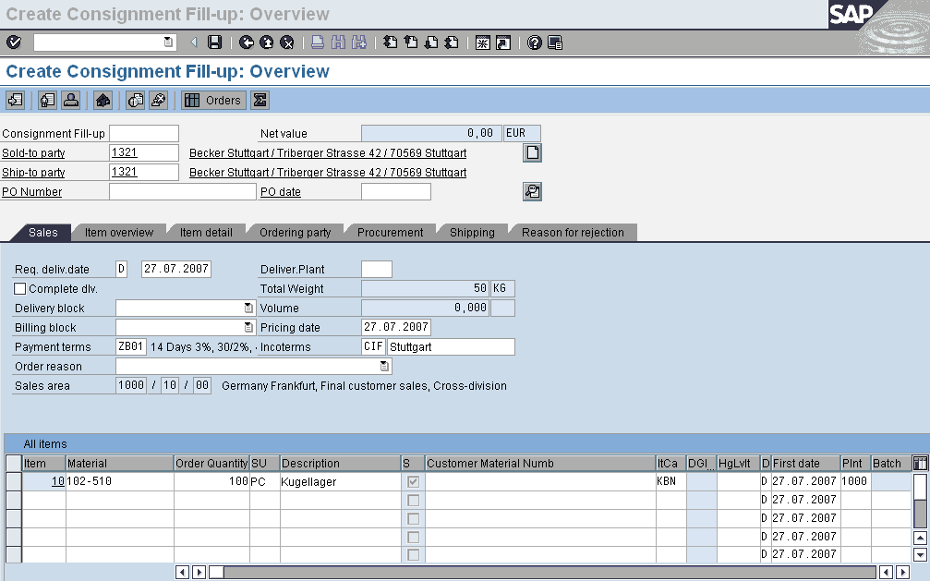
Consignment Fill-up-order Processing
The transaction wherein the business delivers stock to a customer on consignment is recorded using order type CF/KB

Slide 43
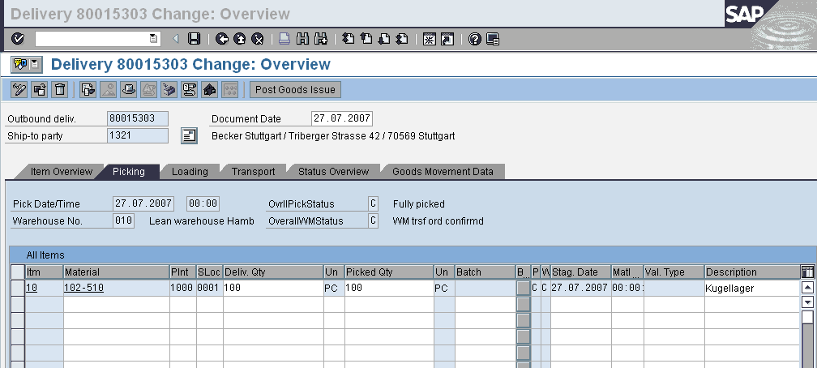
Consignment Fill Up – Delivery Processing
The consignment fill-up order type is then followed by a standard delivery – LF
The document is relevant for Picking and PGI as it ensures the creation of consignment special stock for the customer

Slide 44
Consignment Fill-up - Stock Overview
When the goods issue is posted –
  A special stock is created for the customer
  The order quantity is moved from unrestricted use stocks in the plant and added to the special stock for the customer
The goods remain in the possession of the customer, but not the property of the customer
The total valuated stock for the plant remains the same

Slide 45
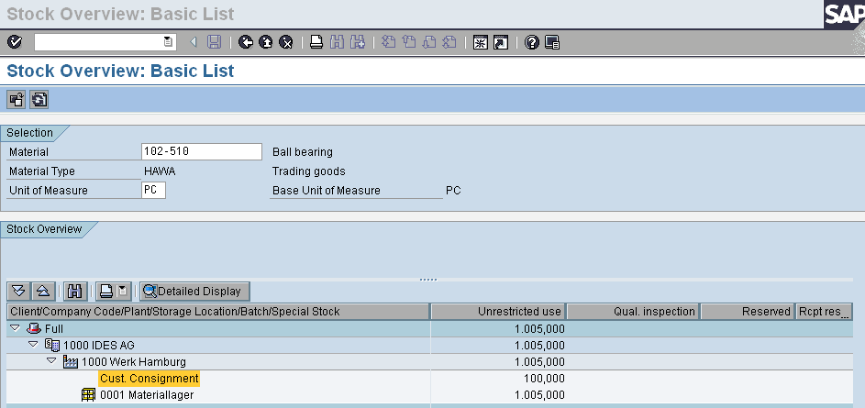
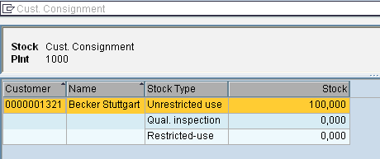
Consignment Fill-up - Stock Overview

Slide 46
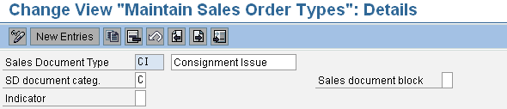
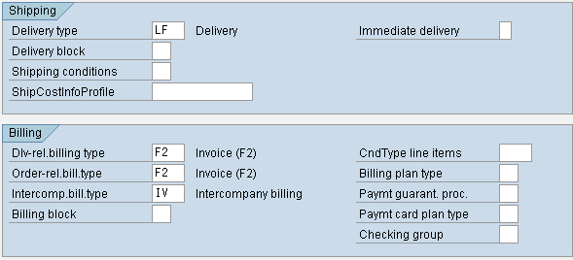
Consignment Issue – Order Type
Standard sales order document type – CI/KE
Followed by standard delivery type – LF
Delivery related billing type – F2 is defined for this order type

Slide 47
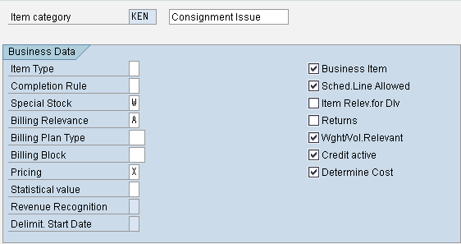

Consignment Issue - Item Category
The standard item category used is KEN
The item is relevant for pricing & billing-delivery related
Special stock indicator-W is maintained

Slide 48


Consignment Issue - Schedule Line Category
Standard schedule line categories - C0 and C1
Schedule line C1 performs MRP and availability check
Goods movement type-633 checks for the available consignment stock at the customers place

Slide 49
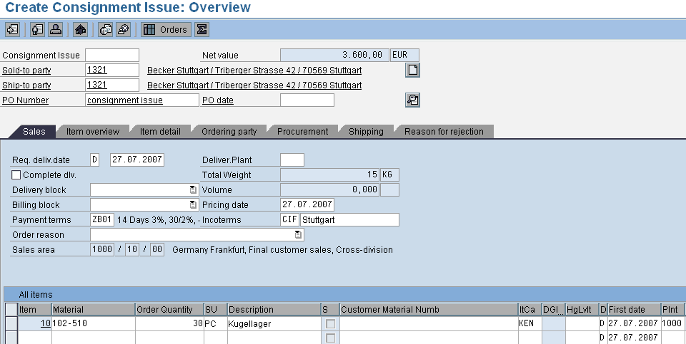
Consignment Issue – Order Processing
The business issues the sale, for the quantity consumed, to the customer thru the order type – CI/KE

Slide 50
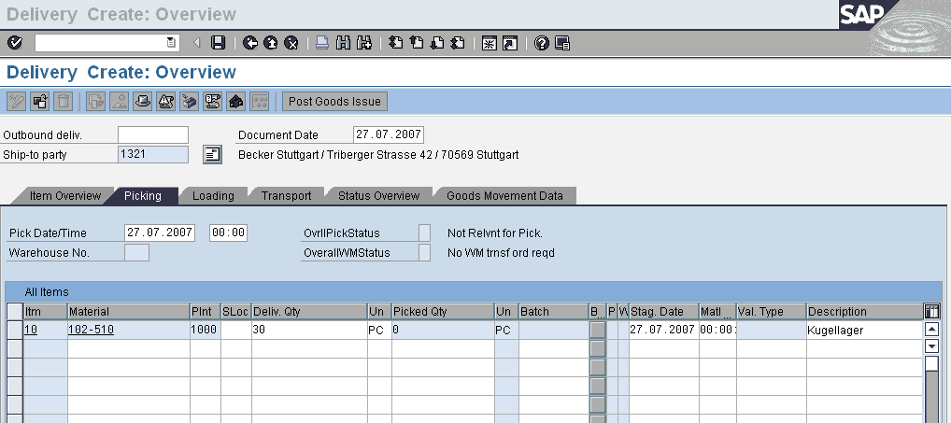
Consignment Issue – Delivery Processing
The consignment issue order type is followed by a standard delivery – LF
LF is not relevant for Picking as the goods being dealt are from the special stock already marked for the customer
The goods issue triggers the transfers of goods ownership from the business to the consignment consumer

Slide 51
Consignment Issue – Stock Overview
When the goods issue is posted –
  The order quantity is deducted from both the customer’s special stock and the business own total valuated stock
  The goods become the property of the customer

Slide 52
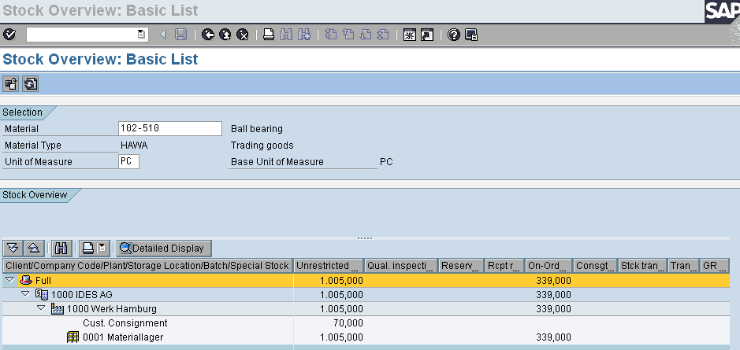
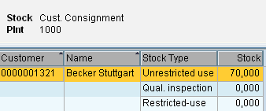
Consignment Issue – Stock Overview

Slide 53
Consignment Returns – Order Type
Sales order document type – CONR/KR
Order is assigned returns delivery document type – LR
Order is relevant for order related billing type-RE
Billing block is proposed to check if the credit is authorized and valid

Slide 54
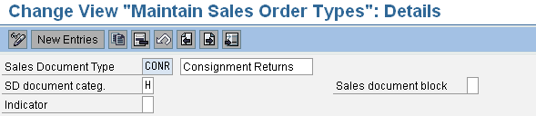
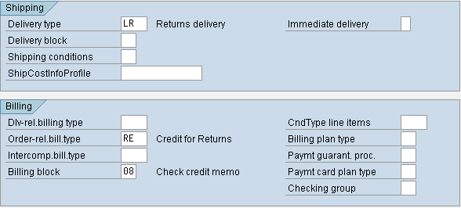
Consignment Returns – Order Type

Slide 55
Consignment Returns – Item Category
Consignment returns uses item category - KRN
Special stock indicator – W is maintained indicating consignment process
The item is relevant for pricing and order relevant billing based on the order quantity

Slide 56
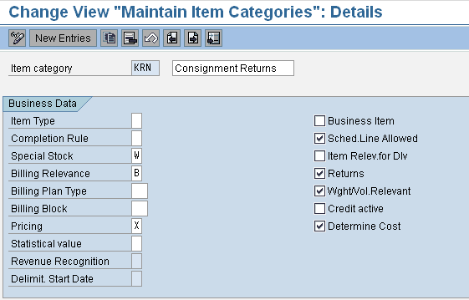

Consignment Returns – Item Category

Slide 57
Consignment Returns – Schedule Line Category
The standard schedule line category used for consignment returns is D0
The schedule line used standard movement type – 634
No transfer of requirements and availability check are carried out as the goods are being received back to the consignment stock at the customers site

Slide 58


Consignment Returns – Schedule Line Category

Slide 59
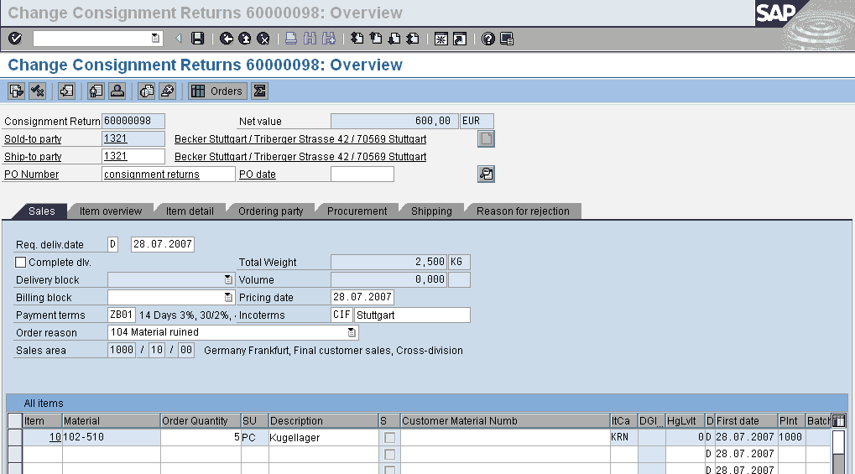
Consignment Returns – Order Processing
The faulty materials returned back by the customer is represented by the sales order document type- CONR/KR

Slide 60
Consignment Returns – Delivery Processing
The returns are recorded in the standard returns delivery document type– LR
PGR causes the stock to move back into the customers consignment stock
The ownership of the goods is passed from the customer back to the business

Slide 61
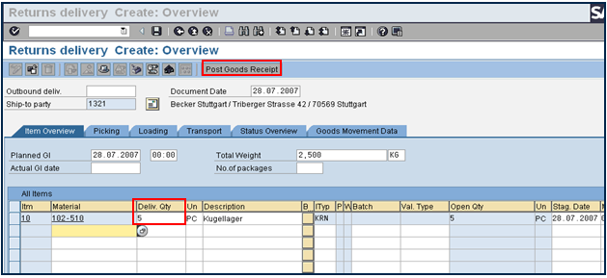
Consignment Returns – Delivery Processing

Slide 62
Consignment Returns - Stock Overview
When goods receipt is posted, the returns quantity is added to the customer’s special stock at the plant where the goods are returned
Thus the customers consignment stock will increase by the returns quantity

Slide 63
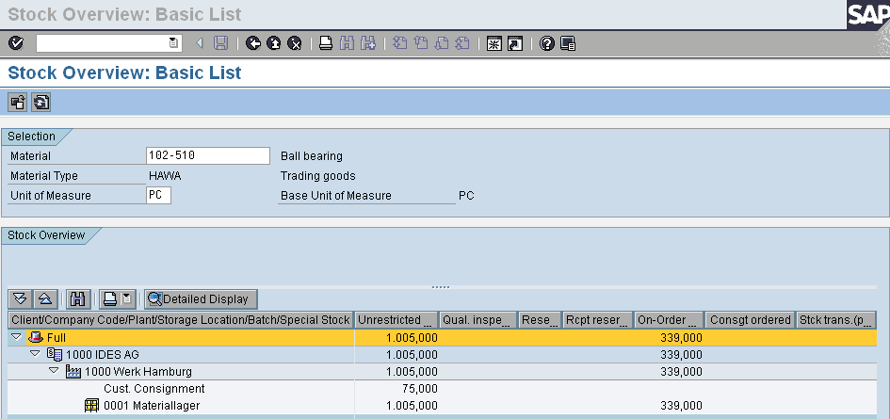
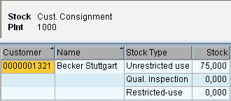
Consignment Returns - Stock Overview

Slide 64
Consignment Pick-up – Order Type
Represented by the order document type – CP/KA
Standard returns delivery type – LR is configured
The transaction is not relevant for billing. Hence no values are maintained for delivery and order-related billing types

Slide 65
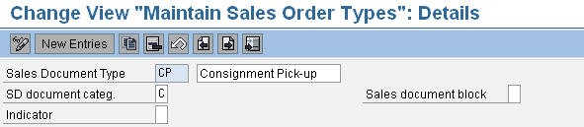
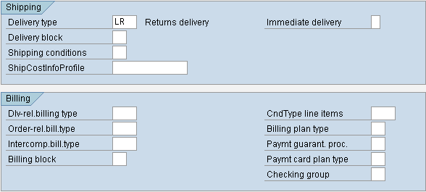
Consignment Pick-up – Order Type

Slide 66
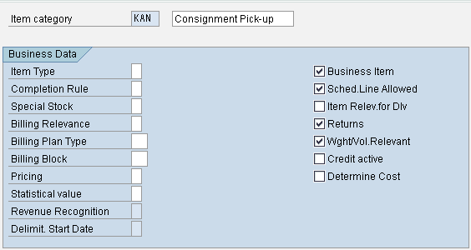

Consignment Pick-up - Item Category
Uses the standard item category – KAN
The item is not relevant for billing & pricing as the stock is coming back into the warehouse and hence there is no change of the ownership

Slide 67
Consignment Pick-up – Schedule Line Category
Uses the standard schedule line categories – F0 and F1
Schedule line category F1 is relevant for transfer of requirements and availability check
Availability check is carried against the stock on the customers consignment
It has standard movement type - 632

Slide 68


Consignment Pick-up – Schedule Line Category

Slide 69

Consignment Pick-up – Order Processing
All the excess material lying unconsumed and any faulty material at the customers site are brought back to the business using the order document type –CP/KA

Slide 70
Consignment Pick-up – Delivery Processing
Delivery is carried out using the standard returns document type-LR
Goods receipt posts the stock back to the business warehouse

Slide 71

Consignment Pick-up – Delivery Processing

Slide 72
Consignment Pick-up – Stock Overview
With the PGR the quantity gets deducted from the customer’s special stock and is added back into the regular stock at the plant where the goods are returned
The total valuated stock remains the same since the returned stock was regarded as part of the business own inventory even while it was at the customer’s premises

Slide 73


Consignment Pick-up – Stock Overview

Slide 74
Free Of Charge Deliveries
The transaction wherein the business send samples or free products, free of charge, is recorded using the order document type – FD
The order is actually only relevant for deliveries and not invoicing. The delivery type used is the standard delivery type- LF
The item category – KLN is not relevant for billing and pricing

Slide 75






Free Of Charge Deliveries

Slide 76
Subsequent Delivery Free Of Charge
A free of charge subsequent delivery document-SDF is used to send products later to the customer free of charge against any complaints made by the customer
The standard delivery type – LF is configured for this transaction
The transaction is not relevant for billing as the items are free
The standard item category- KLN is used which is not relevant for billing and pricing

Slide 77




Subsequent Delivery Free Of Charge

Slide 78
Third Party Order
The processing of third-party orders is controlled via material types which define whether a material is produced only internally, can be ordered only from third-party vendors, or whether both are possible
If a material is always delivered from one or more third-party vendors, material is maintained as third-party item. BANS is entered in the Item category group field in the Sales 2 screen of the material master record. System determines the item category as TAS while processing the material in the order
In the case of a material that business delivers itself but occasionally orders from a third-party vendor, the item category of the material is manually changed from TAN to TAS during sales order processing

Slide 79

Third Party Order

Slide 80


Third Party Order –Item Category
The item Category TAS is relevant for order related billing, quantity as per the goods receipt
The item is also relevant for pricing

Slide 81
Third Party Order–schedule Line Category
Standard third party schedule line – CS
The schedule line is not relevant for any goods movement type as the physical goods issue does not take place from the business
The standard purchase requisition-NB, Third party item category – 5 and third party account assignment Category – 1 are configured to enable the system to automatically create a purchase requisition for the schedule line

Slide 82


Third Party Order–schedule Line Category

Slide 83
Third Party Order Sales
Third-party items are processed by creating a normal sales order
The system uses TAS as the standard third party item category
A sales order may consist partly or wholly of third-party items

Slide 84

Third Party Order Sales

Slide 85
Third Party Order – Purchase Requisition
Purchase requisition is automatically created in purchasing
once the sales order is saved
Each third-party item in a sales order automatically
generates a corresponding purchase requisition item
If a third-party order item has more than one schedule line, the system creates a purchase requisition item for each schedule line

Slide 86

Third Party Order – Purchase Requisition
System automatically determines a vendor for each requisition item.
Purchase requisition items can be viewed from the schedule line of the sales order.

Slide 87
Third Party Order – Purchase Order
Purchase order is created with reference to the purchase requisition
The system automatically adopts the delivery address of the recipient from the sales order
Third-party order items in purchase orders are marked with item category S
Any quantity and date changes made in the purchase order are automatically copied into the sales order

Slide 88

Third Party Order – Purchase Order

Slide 89

Third Party Order – Billing
Once the goods have been delivered to the customer by the
vendor, the business then bills the customer
No delivery exists in the system for third-party order items
The system is set for order related billing during selection of the
documents to be billed

Slide 90

Inter Company Stock Transfer-configuration for Order Types
As the supplying and receiving plants belong to different company codes, document type – NB, is configured for the required combination of supplying and receiving plants
A physical stock transfer is then carried out with delivery and billing document
Depending on the supplying and issuing plants, the stock transfer can be executed according to the one-step or two-step procedure
  With the one-step-procedure, the goods receipt in the receiving plant is posted at the same time as the goods issue in the issuing plant
  With the two-step procedure is to be used, the goods receipt is posted as soon as the goods are received in the receiving plant

Slide 91

Intercompany Stock Transfer-Configurations
Configurations are done to determine whether an SD delivery is to be created in the case of a PO for the required combination of supplying plant and document type
Delivery type is assigned to replenishment delivery for cross-company stock transfer
The delivery type determines how a delivery is to be handled
In case, stock transfers are created with a billing document, the delivery type 'NLCC' is used. The delivery type 'NL' is used for stock transfers without a billing document

Slide 92
Intercompany Stock Transfer-Configurations
Assign Internal Customer number
  An internal customer number for the particular sales area is assigned to the receiving plant. This customer number is used to represent the plant when an inter company invoice is created
Define Shipping Data for Plants
  The shipping data is maintained for plants for stock transfer processing. Sales area is defined for the supplying plant, with the help of which the system determines the shipping data for the material to be transferred (e.g. the shipping point)

Slide 93


Intercompany Stock Transfer-Configurations

Slide 94

Intercompany Stock Transfer-Master Data
Material is created and extended to all the sales areas and plants participating in Inter Company Stock Transfer

Slide 95

Transaction Steps – Order Processing
The inter company stock transport order is recorder using the standard purchase order type NB
The stock transport order is created in the receiving plant
Vendor is entered in the order. The system determines the delivering plant by using the master data of this vendor
Receiving Plant
Sales area from the supplying plant

Slide 96

Master Data - Vendor
A plant is assigned to the vendor in the vendor master record
This plant is derived by the system from the vendor entered in the purchase order. This plant is called the delivering plant
Delivering Plant

Slide 97
Transaction Steps – Stock Overview
In case of inter company stock transfers, the stock overview of the delivering plant shows the ordered quantity under the “StockTrsptOrderRel” stock type
The ordered quantity is shown as “Open Order Qty” stock type in case of the receiving plant

Slide 98



Transaction Steps – Stock Overview

Slide 99
Transaction Steps-Delivery
The replenishment delivery is created with respect to the stock
transport order, in the respective shipping point
Replenishment delivery type - NLCC is derived from the
combination of the purchase order document type – NB and the
delivering Plant – 1200

Slide 100

Transaction Steps-Delivery

Slide 101

Transaction Steps-Delivery Header Details

Slide 102



Transaction Steps-Delivery Item Details

Slide 103
Transaction Steps-Stock Overview
Once the goods issue is posted, the stock types "unrestricted-use
stock" and "Deliv. to customer“, are reduced by the delivered
quantity in the stock overview of the delivering plant
In the receiving plant, the unrestricted-use stock and the open
order quantity remain unchanged. The quantity that is "in transit“
is shown in the stock overview of the receiving plant as "Stock in
transit CC“

Slide 104



Transaction Steps-Stock Overview

Slide 105
Transaction Steps –Inter Company Billing
The delivering company code issues an invoice for inter company
billing of the goods delivered to the receiving plant
The internal invoice is created with direct reference to the
replenishment delivery by the delivering sales organization
An incoming invoice with reference to the purchase order can be
posted in the following ways:
  Manually, after the invoice has been checked
  Automatically, with an internal billing document via SAP EDI

Slide 106


Transaction Steps –Inter Company Billing
Derived from Receiving plant
Derived from Delivering Plant
Derived from Payer
Derived from Delivering Plant

Slide 107
Transactions
VOV8 | Define Sales Document Types | IMG ->Sales and Distribution -> Sales -> Sales Documents -> Sales document header -> Define sales document types
VOV7 | Define Item categories for Sales Document Types | IMG ->SD-> Sales -> Sales Documents -> Sales document Item -> Define Item Categories
VOV6 | Define schedule Line Categories | IMG ->Sales and Distribution -> Sales ->Sales Documents ->Schedule Lines -> Define Schedule Line Categories
VOV5 | Assign Item categories | IMG ->SD-> Sales -> Sales Documents -> Sales document Item -> Assign Item Categories
VOV4 | Assign Schedule Line Category | IMG ->Sales and Distribution -> Sales ->Sales Documents ->Schedule Lines -> Assign Schedule Line Categories
OVLK | Define Delivery Types | IMG ->Logistics Execution ->Shipping ->Deliveries ->Define delivery types
OVLP | Define Item categories for Deliveries | IMG ->LE ->Shipping ->Deliveries ->Define item categories for deliveries

Slide 108
Transactions
MMBE | Display Stock Overview | Easy Access -> Logistics -> MM-> Inventory Management -> Environment -> Stock -> Stock Overview
MB58 | Display Customers Stock Overview | Easy Access-> Logistics -> MM-> Inventory Management -> Environment -> Consignment ->Consignment at Customer
SPRO | Change view Stock Transport Order | IMG -> MM ->Purchase Order -> Set up Stock Transport Order -> Define Shipping Data for Plants
SPRO | Assign Delivery Type and Checking Rule | IMG -> MM ->Purchase Order -> Set up Stock Transport Order ->Assign Delivery Type and Checking Rule
SPRO | Assign Document Type | IMG -> MM ->Purchase Order -> Set up Stock Transport Order ->Assign Document Type
MM01/02/03 | Create / Change / Display Material | Easy Access -> Logistics -> SD -> Master Data -> Products -> Material -> Other Material -> Create / Change / Display
XD01/02/03 | Create / Change / Display Customer | Easy Access -> Logistics -> SD-> Master Data -> Customer -> Create / Change / Display

Slide 109
Transactions
VA01 / 02 / 03 | Create / Change / Display Sales Order | Easy Access -> Logistics -> Sales & Distribution -> Sales -> Order -> Create / Change / Display
VL10B | Collective processing of Delivery against Purchase Order | Easy Access -> Logistics -> Sales & Distribution -> Shipping and Transportation -> Outbound Delivery -> Collective Processing of Doc due -> Purchase Orders
ME21N / 22N / 23N | Create Purchase Order | Easy Access -> Logistics -> MM -> Purchasing -> Purchase order - > Create / Change / Display
ME51N / 52N / 53N | Create Purchase Requisition | Easy Access -> Logistics -> MM -> Purchasing -> Purchase Requistion - > Create / Change / Display
VL01N / 02N /03N | Create / Change /Display Delivery | Easy Access -> Logistics -> Sales & Distribution -> Shipping and Transportation -> Outbound Delivery -> Create / Change / Display
VF01 / 02 / 03 | Create / Change /Display Billing | Easy Access -> Logistics -> SD-> Billing -> Billing document -> Create / Change / Display

Slide 110
Additional Info
The cash sale can be billed only when the order quantity is the same as the goods issue quantity. Hence the cash sale document has to be adjusted so that the delivered quantity and the quantity to be billed match
Consignment goods can also be posted to the stock of the special stock partner when goods issue is carried out by maintaining the special stock partner (SB) in the relevant customer master record
Any changes with regards to the address data for the ship-to party can be changed only in the sales order for third-party business transactions, which then gets automatically updated into the purchase order via purchase requisition

